Slide 1
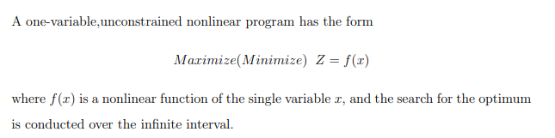
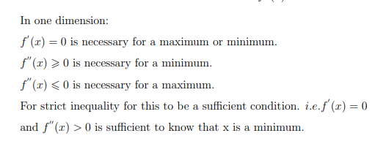
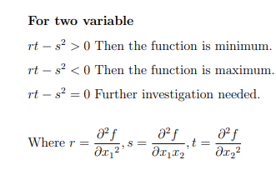

Slide 2
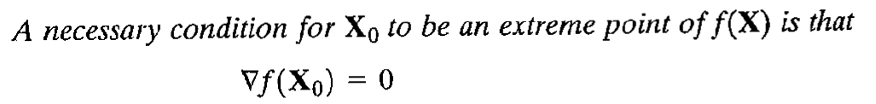
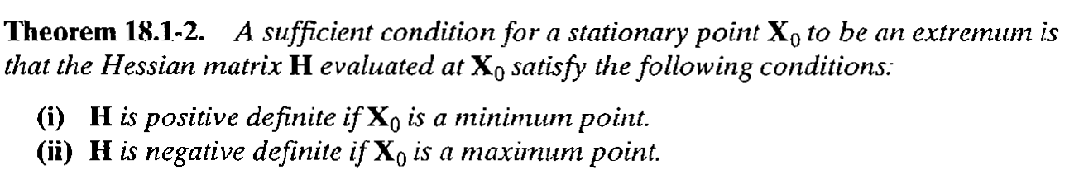
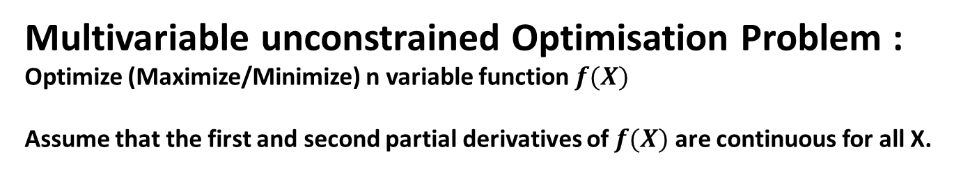
Multivariable unconstrained Optimisation Problem :
Optimize (Maximize/Minimize) n variable function $f(X)$
Assume that the first and second partial derivatives of $f(X)$ are continuous for all X.
Theorem :

Slide 3
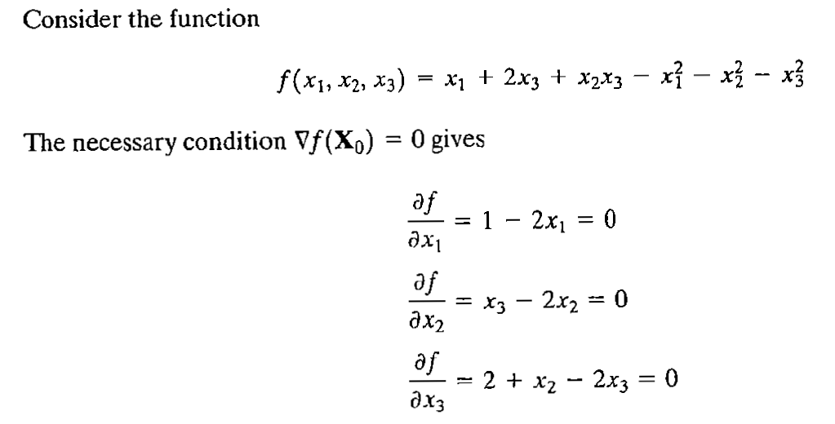
Example :

Slide 4
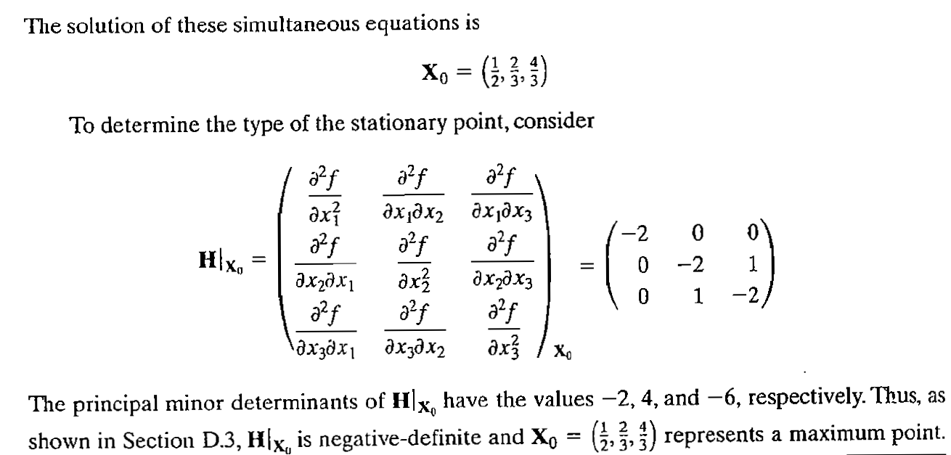
(Verify !)
by above said theorem

Slide 5
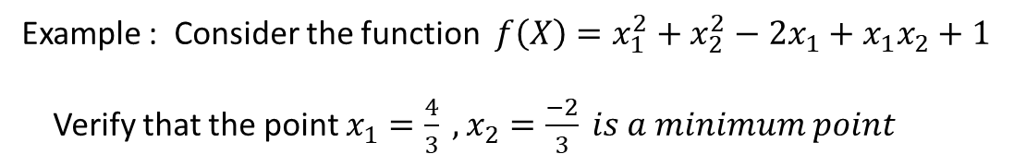
Example : Consider the function $f\left(X\right)=x_{1}^{2}+x_{2}^{2}−2x_{1}+x_{1}x_{2}+1$
Verify that the point $x_{1}=\frac{4}{3} , x_{2}=\frac{−2}{3} is a minimum point$

